Slide 1
Sprint Report 1
FRASS-MOBWEB

Slide 2
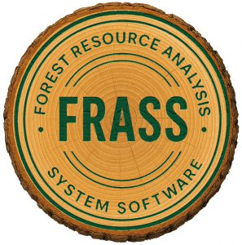
Introduction
Sprint 1 focused on understanding the project and creating a high level design.
We chose to work with C# .NET MAUI as our cross platform framework.
Credit: Forest-Econometrics

Slide 3
Sprint Objectives
Understand the wider FRASS system
Evaluate app framework options
Identify client requirements and convert to FR and NFR
Begin development of features

Slide 4
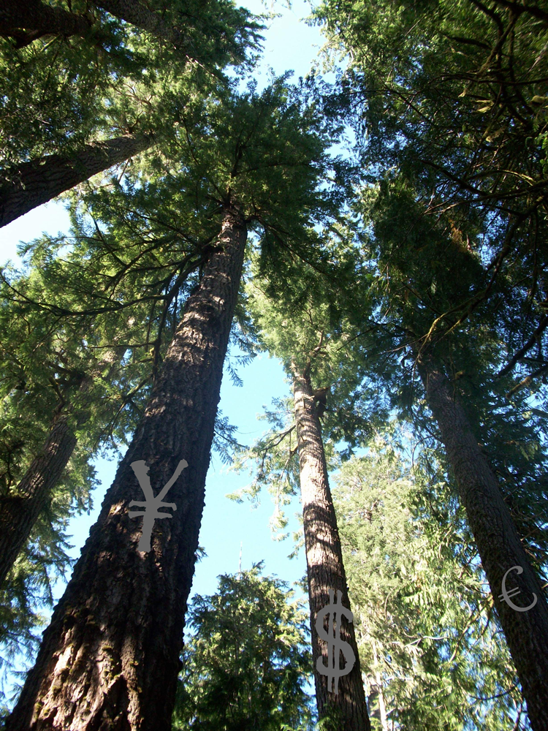
Gathering Requirements
Weekly Meetings W/Client
Received numerous requirements documents
Discussed app design from a user and operator perspective
Credit: Forest-Econometrics

Slide 5
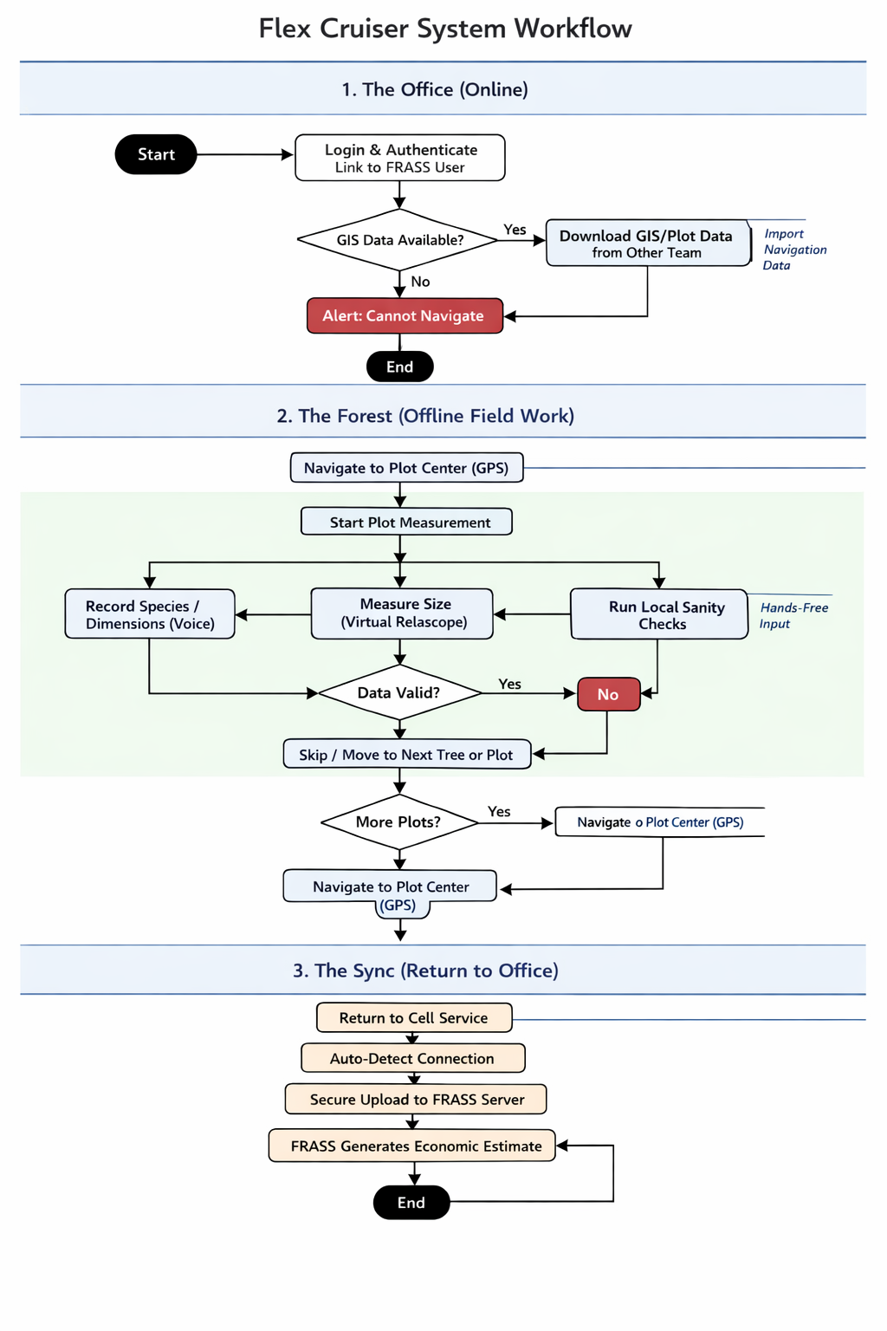
User Stories, Use Cases, UML Diagrams
User Stories
Retrieve assigned cruise plan
Activate plot and number trees
Enter tree data (species, DBH, height)
Validate unusual measurements
Upload completed cruise
Use Cases
Cruise Retrieval (Forester ↔ Server)
Plot Activation
Tree Data Entry & Sanity Check
Nearest Plot Navigation
Upload & Data Synchronization

Slide 6
Example: UC-04: Plot In-Out Calculation
Actors | Forester
Pre-condition | Cruise active. Plot activation started
Post-condition | Plot activated. Relevant boundary-tree calculations are recorded.
Main Flow | - During plot activation, forester encounters edge-case; a tree is nearly in or out of the plot boundary criteria. - Forester inputs measurements of nearest-face distance to plot center. - App auto-calculates In-Out metric depending on the cruise settings. - Forester counts tree or as within or outside plot bounds. In either case, calculation is recorded and stored.
Alternative Flow | - Cruiser can tentatively record an edge-tree's data, making the final decision to include or exclude it later.
Related Requirements | FR-1: Plot Activation

Slide 7
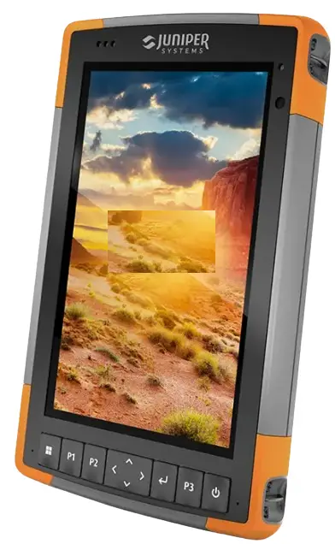
Evaluation of Existing Solutions
Paper and Tally Cards: Cheap and reliable, but requires manual typing back at the office, leading to transcription errors and no automatic GPS tracking.
Dedicated Handheld Loggers (e.g., Allegro): Rugged and work offline, but the hardware is prohibitively expensive ($2,000+) and the software is notoriously outdated.
Generic Form Apps (e.g., Survey123): Can run on normal smartphones, but they lack forestry-specific math (like slope correction) and can't use device sensors for measurements.
The Flex Cruiser Advantage: Solves these gaps by turning an inexpensive, everyday smartphone into a specialized forestry tool with custom math, sensor integration (gyroscope for height), and direct data formatting for the FRASS backend.
Image Credit: Juniper Systems

Slide 8
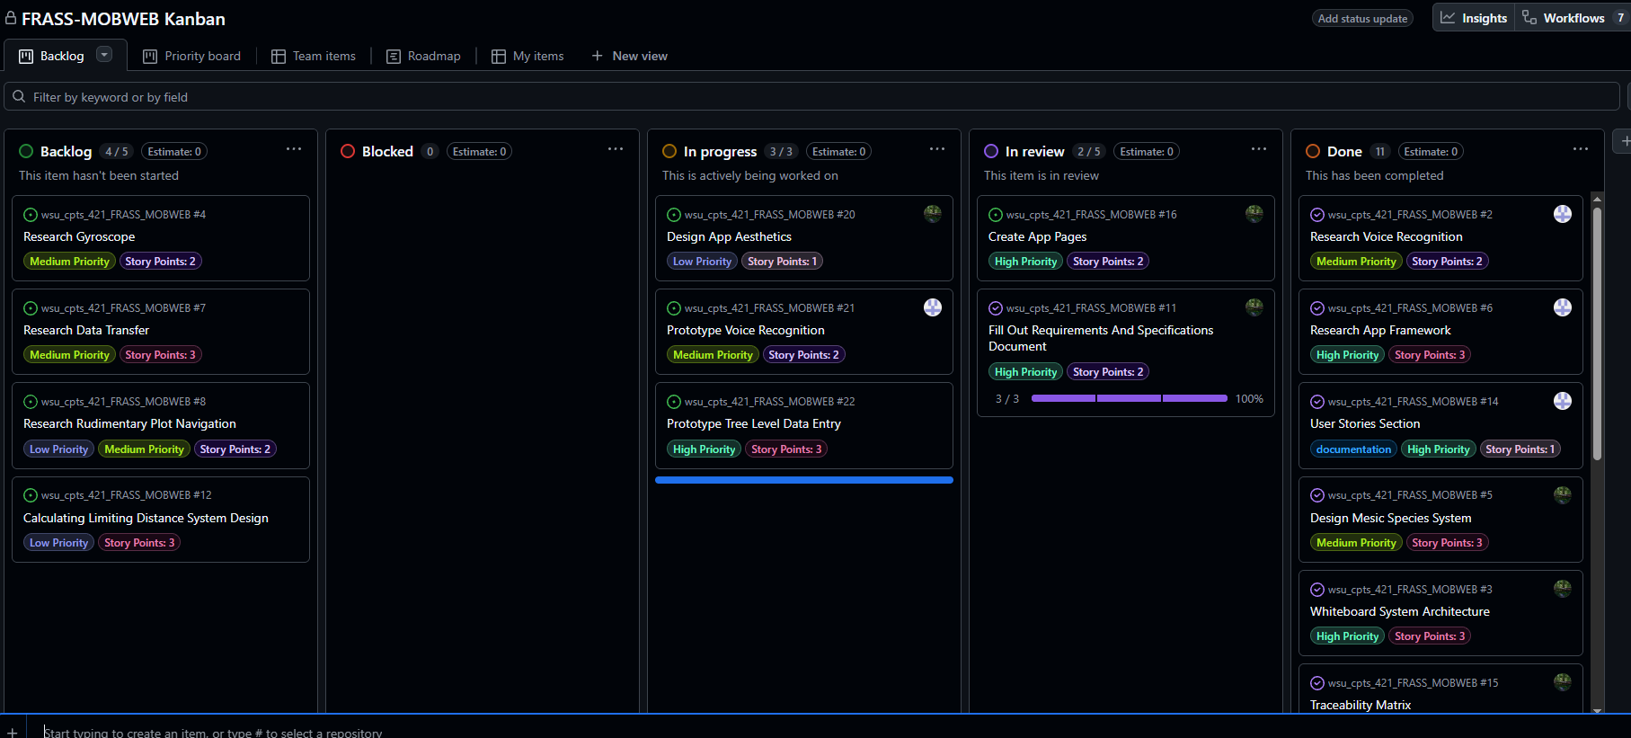
Kanban Overview

Slide 9
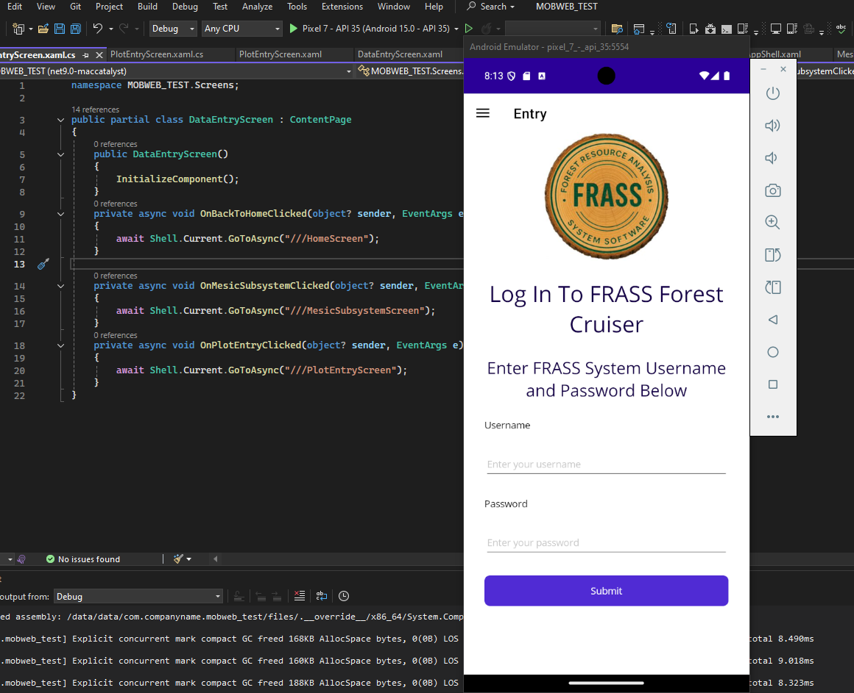
Feature Demo

Slide 10
Skills ID
All
-Learn more about .NET MAUI and its libraries
-Learning GitHub actions
-Using Kanban
Samuel
Voice Recognition Interfaces
Cross-platform dev setups

Slide 11
Sprint Achievements
Offline Data Storage: Designed the database so the app can save tree data completely offline while out in the woods.
Smart Voice Input: Planned how the app will listen to voice commands and automatically catch bad data (like accidentally logging a 500-inch tree).
Phone Sensor Math: Figured out the math needed to measure tree height just by tilting the phone.
Safe Server Uploads: Designed a "save now, upload later" system so data is safely pushed to Dr. Bill's server only when the phone gets back to Wi-Fi.
Field-Friendly UI: Planned the screen layout with big, easy-to-reach buttons designed for a forester working one-handed or wearing gloves.

Slide 12
AI Use
Used Generative AI to research potential framework
Utilized AI to search for specific documentation on Dotnet MAUI
Used Github’s AI Commit Message Feature

Slide 13
Next Steps
Focus for Next Sprint (Sprint 2):
Transition from system design to actual active development.
Build the foundational UI screens (XAML forms) for plot and tree data entry.
Implement the local SQLite database to prove we can successfully save and retrieve data entirely offline.
Develop subsystems to improve technical maturity

Slide 14
Retrospective
What Went Well:
Solidified Architecture: Successfully mapped out the offline-first database structure (SQLite) and data flow before writing code.
Solved Key Dependencies: Created a reliable backup plan (Excel file imports) so the project won't stall if the GIS team's map API is delayed.
Defined Sensor Logic: Figured out the exact math and triggers needed to use the phone's gyroscope and accelerometer for forestry measurements (like the hypsometer tool).
Challenges Encountered:
Forestry Math Translation: It took time to translate complex, physical forestry concepts (like Variable Radius plots and Live Crown Ratios) into logical software steps.
Framework Learning Curve: Getting familiar with the specific requirements and structure of .NET MAUI for cross-platform mobile development.

